Slide 1
Module2: Yelp Reviews
By Xiaohan Wang, Tiannan Huang and Siyu Wang
Tues Group3

Slide 2
Outline of this presentation
Kaggle prediction on stars of reviews
Bag-of-words Model
Deep Learning Model
Business analysis of the Wicked Spoon restaurant
Attributes Analysis
Pre-defined Season Analysis
Detect Seasonal Trend
Suggestions

Slide 3
Bag-of-words
Using Linear / Naïve Bayes / Logistic / SVM
Few of them reach the threshold on test data.
Below is result using 10k data
 | Frequency-RMSE | TF-IDF RMSE | Boolean RMSE
Naïve Bayes | 0.986 | 1.056 | 0.975
Linear Model | 0.964 | 0.892 | 0.961
Logistic | 1.101 | 0.933 | 0.953
SVM | 1.000 | 0.909 | 0.959

Slide 4
Deep Learning
One layer LSTM (Input - Embedding - LSTM - Output)
Embedding：Keras built-in
LSTM: Tune the number of hidden_nodes
100k data
Final result on Kaggle: 0.81

Slide 5
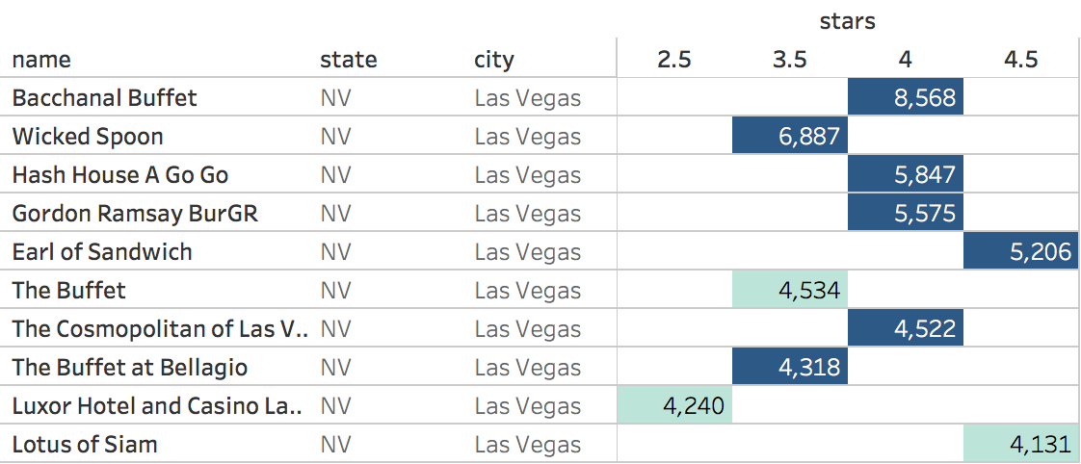
Business Analysis --- Recap
Pick a specific restaurant: Wicked Spoon

Slide 6
Aspect Term Extraction (ATE)
Why use review.json rather than business.json ?
Use spacy (a package) to find the root in a sentence and its dependency
The table below shows the most meaningful roots and its dependency in 2177 five-star reviews
Word | Ratio of No. Mentioned | Some reviews
desserts | 20.2% | a wide variety of desserts / look totally fresh and custom made / overall very pretty but unique looking.
cheese | 16.8% | Devils Mac and cheese, soooo gooood!!!
marrow | 13.3% | The bone marrow is a must try.
salad | 10.7% | mini / beet / kale / caesar salad
chicken | 13.0% | Fried chicken / the king pao chicken was exceptional.

Slide 7
Aspect Term Extraction (ATE)
The table below shows the most meaningful roots and its dependency in 507 one-star reviews
Word | Ratio of No. Mentioned | Some reviews
line | 28.8% | Ate at 6pm, waited in line to pay, waited in line to get seated then waited in line to serve myself.
legs | 21.1% | Crab legs tasted like water / cold / frozen / broken / …
selection | 18.9% | Limited selection / sucked / pitifull / joke / diminished
sushi | 17.4% | there was no sushi worth mentioning / weird / hard
rib | 12.8% | The prime rib was salty / fat / SO tough, I could not cut it with a knife.

Slide 8
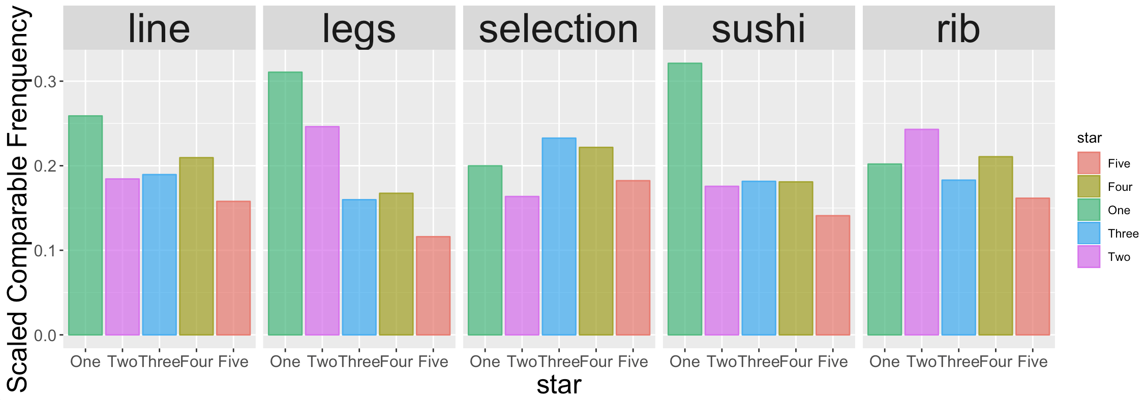
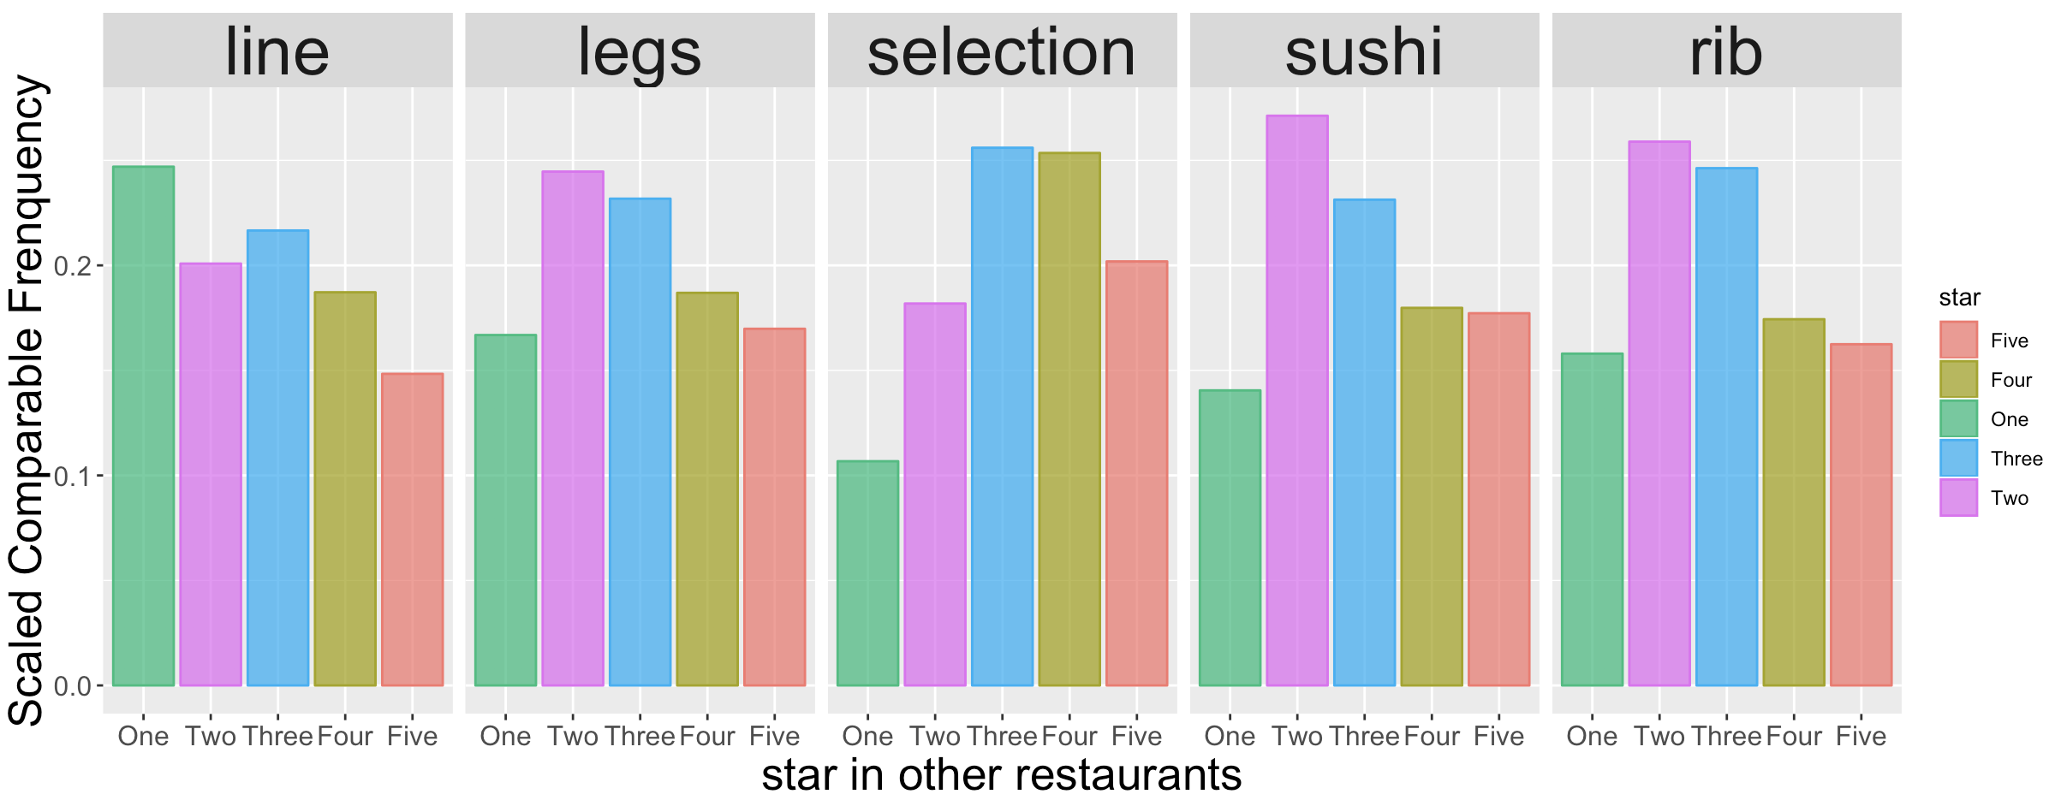
Distribution Plot of Attributes
Wicked Spoon:
Other Restaurants:

Slide 9
Hypothesis Testing on Attributes
If we care more about the distribution of the stars in reviews, we could use chi-square test.
H0: The distribution of reviews with negative attributes is different from the distribution of reviews without negative attributes.
If we care more about the average (median) score, we could use Wilcoxon two-sample test.
H0: The median of reviews with negative attributes is larger than the median of reviews without negative attributes. (One - Sided)

Slide 10
Chi-Square Test
Take line as an example:
 | ONE-STAR | TWO-STAR | THREE-STAR | FOUR-STAR | FIVE-STAR
line appears | 68 | 70 | 129 | 234 | 178
line does not appear | 439 | 663 | 1185 | 1922 | 1999
 | Line | Legs | Selection | Sushi | Rib
P-value | 0.002 | 0.000 | 0.010 | 0.000 | 0.208

Slide 11
Wilcoxon two-sample test
 | ONE-STAR | TWO-STAR | THREE-STAR | FOUR-STAR | FIVE-STAR
line appears | 68 | 70 | 129 | 234 | 178
line does not appear | 439 | 663 | 1185 | 1922 | 1999
Take line as an example:
X = (1…1, 2…2, 3…3, 4…4, 5…5) The counts of 1,2,3,4,5 are 68,70,129,234,178
Y = (1…1, 2…2, 3…3, 4…4, 5…5) The counts of 1,2,3,4,5 are 439, 663, 1185, 1922, 1999
 | Line | Legs | Selection | Sushi | Rib
P-value | 0.003 | 0.000 | 0.182 | 0.000 | 0.046

Slide 12
Result
Combine the previous results:
Some Suggestions
 | Line | Legs | Selection | Sushi | Rib
P-value from Chi-Square | 0.002 | 0.000 | 0.010 | 0.000 | 0.208
P-value from wilcoxon | 0.003 | 0.000 | 0.182 | 0.000 | 0.046

Slide 13
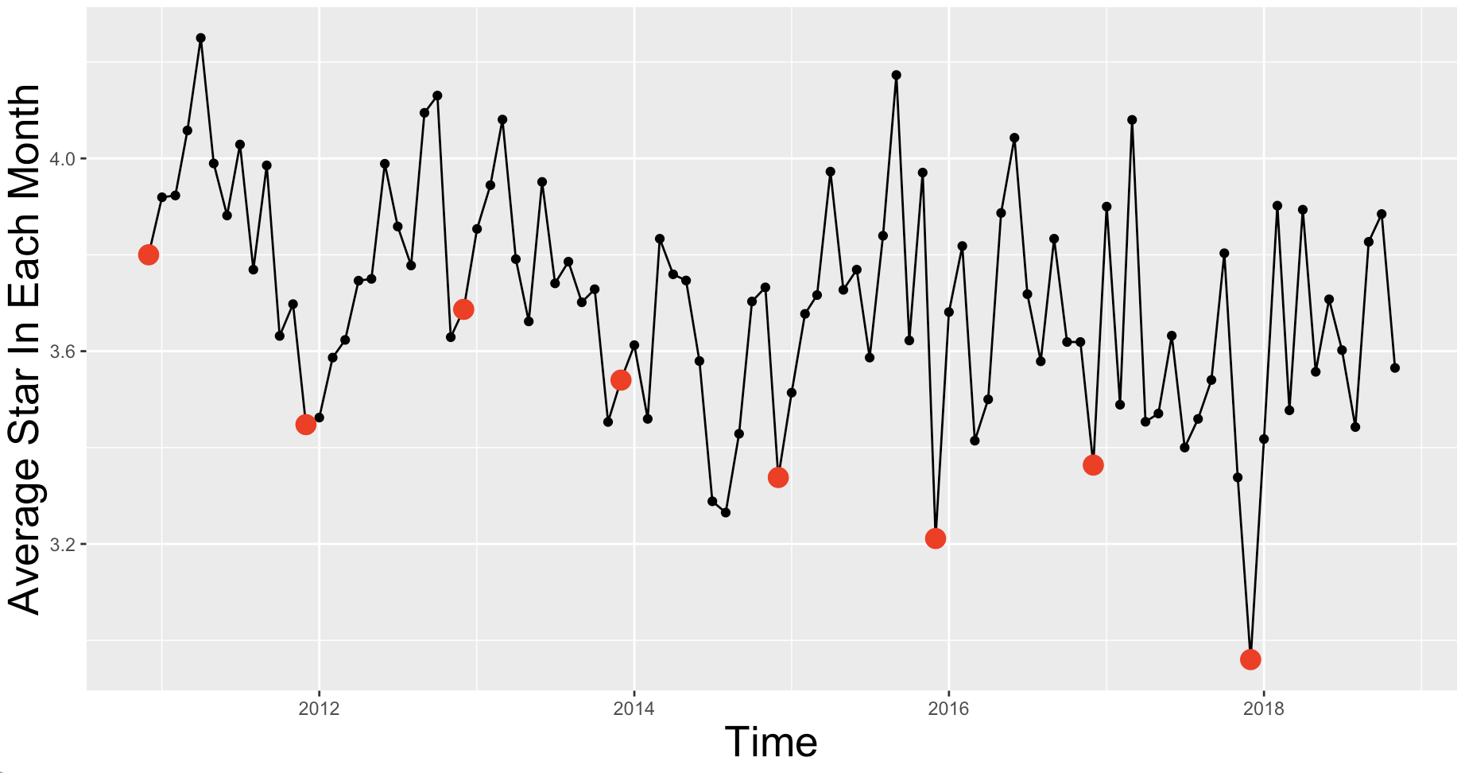
Seasonal Trend - Recap
Red dots denote average stars in December

Slide 14
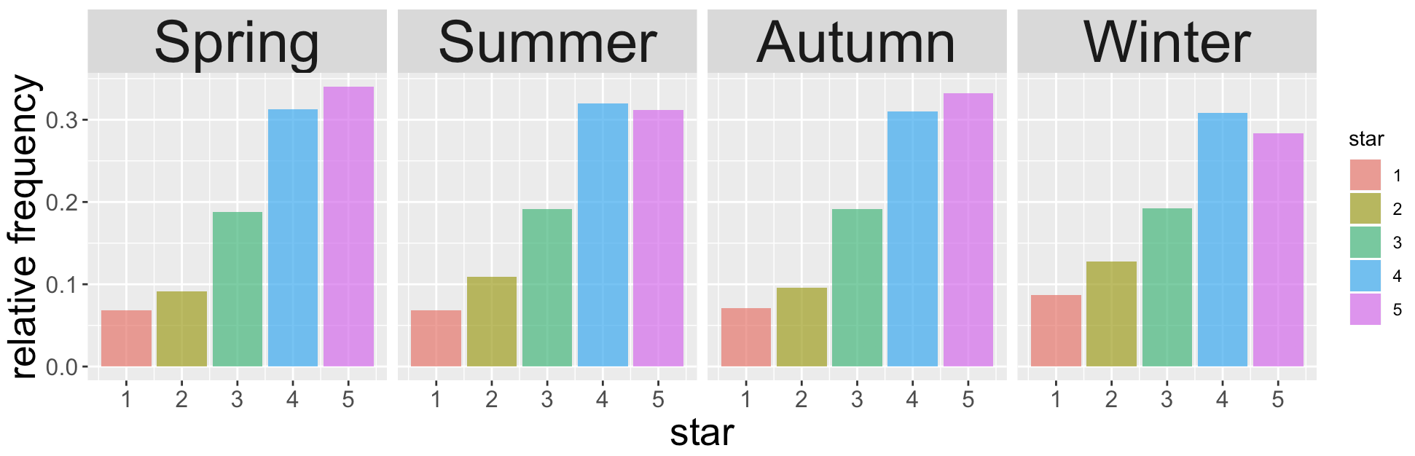
Pre-defined Season
Spring (3 - 5), Summer (6 - 8), Autumn (9 - 11), Winter (12 - 2)
Hypothesis Testing:
 | Chi-square Test | ANOVA | Kruskal-Wallis K-sample test
P-value | 0.004 | 0.000 | 0.000

Slide 15
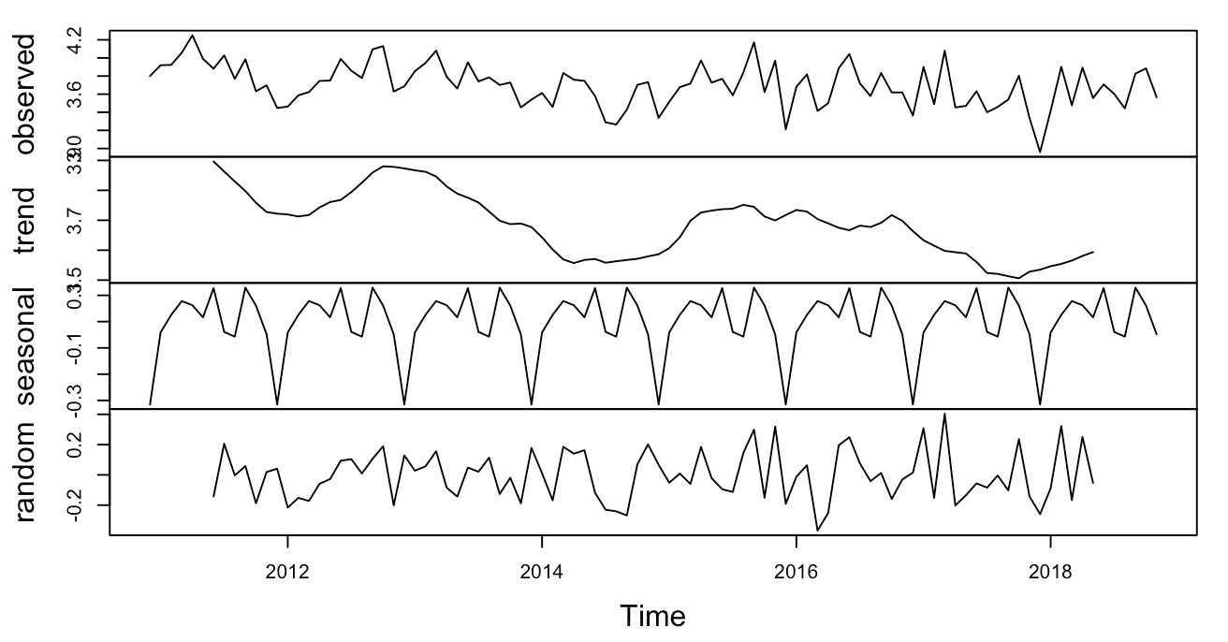
Season Trend
Decompose the time series using MA smoothing.
P-value from Ljung-Box text is 0.3545 White noise

Slide 16
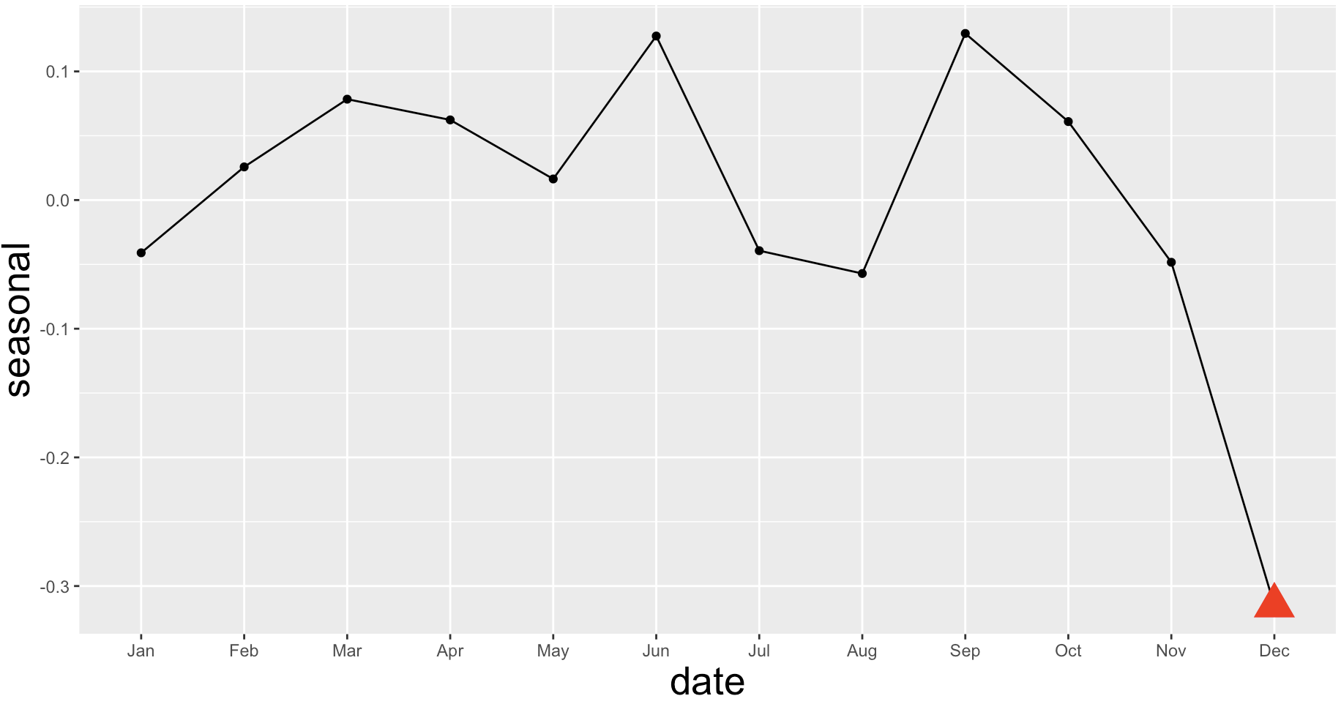
Seasonal Trend
We can see Dec is significant lower than other months.

Slide 17
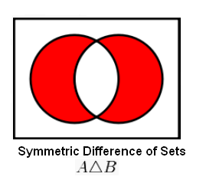
Keywords Searching
Select 100 most common words (root) in december (set A) and other months (set B), find out the words that only appear in one dataset. (symmetric difference)
Words only in Dec | 'cocktail', 'crab', 'decor', 'hours', 'meats', 'minutes', 'money', 'reviews‘, 'sauce', 'soup', 'waiter'
Words not in Dec | 'area', 'cream', 'flavors', 'friends', 'mimosas', 'potatoes', 'salads', 'salmon', 'spoon', 'staff', 'way'

Slide 18
Keywords Analysis
There are several ways to define the importance of a word:
If the word appear much more often in one dataset. (Frequency)
Hypothesis testing. (Wilcoxon and Chi-square)
A/B | Percentage in december | Percentage other month | Wilcoxon_p | Chi-square_p | B/A | Percentage in december | Percentage other month | Wilcoxon_p | Chi-square_p
soup | 1.50% | 1.40% | 0.29 | 0.444 | spoon | 3.90% | 4.10% | 0.31 | 0.502
reviews | 6.10% | 4.20% | 0.13 | 0.464 | staff | 2% | 3% | 0.381 | 0.905
waiter | 1.50% | 1.60% | 0.061 | 0.15 | potatoes | 0.30% | 1.70% | 0.871 | 1
meats | 2% | 2% | 0.048 | 0.002 | flavors | 0.80% | 1.90% | 0.089 | 0.005
minutes | 4.40% | 2.70% | 0.103 | 0.418 | mimosas | 1.80% | 2.90% | 0.359 | 0.671
crab | 5.70% | 6% | 0.119 | 0.817 | salmon | 1.60% | 1.80% | 0.566 | 0.675
decor | 2.30% | 1.80% | 0.338 | 0.469 | cream | 1.80% | 2.70% | 0.429 | 0.716
cocktail | 1.10% | 1.10% | 0.123 | 0.78 | salads | 1.50% | 2% | 0.418 | 0.203
hours | 4.80% | 1.80% | 0.155 | 0.486 | area | 1.10% | 1.80% | 0.993 | 0.168
money | 5.20% | 3.50% | 0.312 | 0.953 | friends | 3.40% | 3.40% | 0.156 | 0.365
sauce | 1.10% | 1.50% | 0.411 | 1 | way | 4.10% | 4.70% | 0.902 | 0.152

Slide 19
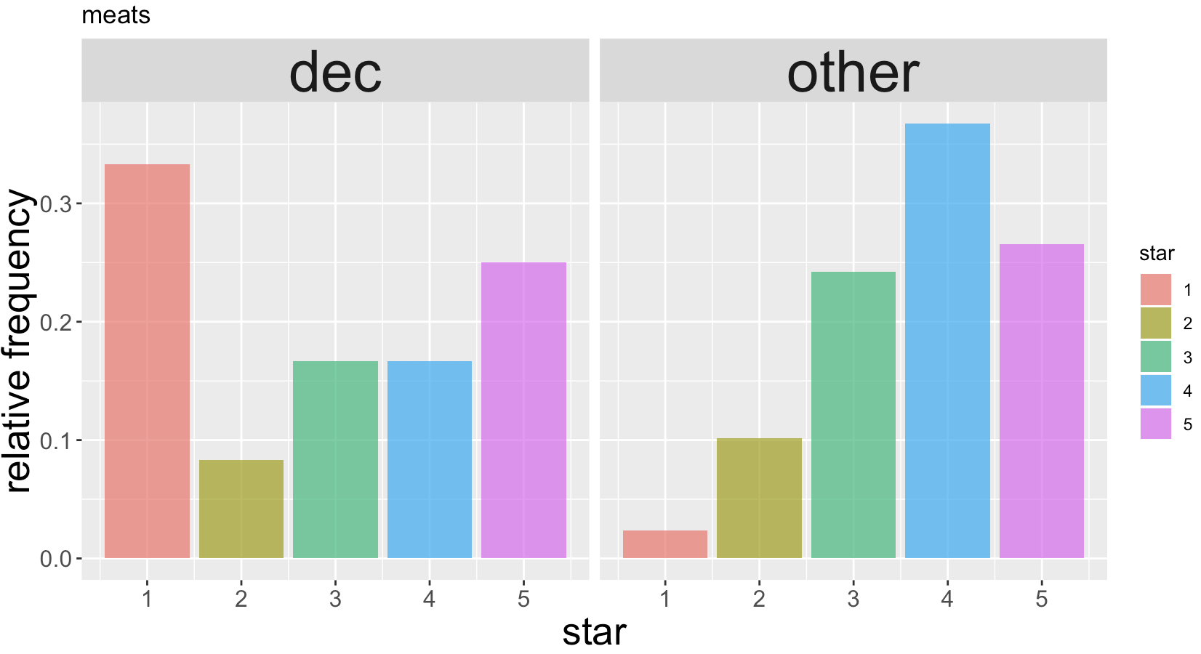
Keywords in Reviews
Then let’s go back to the reviews and see what happens:
meats.
Some of the 1~3 star reviews:
The meats had absolutely no flavor, not even salt
They offer a variety of over salted meats, none of which were particularly good.
A lot of the meats just seemed to be overcooked.
In fact, the carvery is bad - the meats are tough to chew - a sign of low quality.

Slide 20
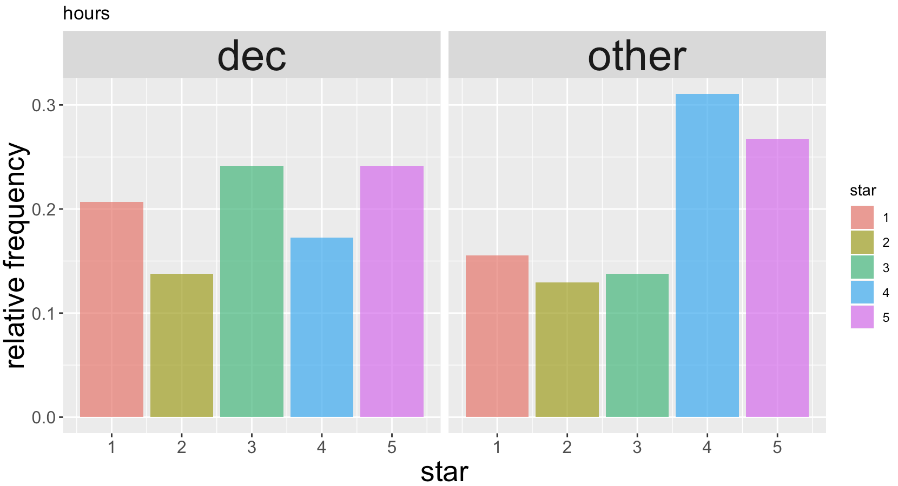
Keywords in Reviews
hours
Some five-star reviews:
Also we called most of the buffets and they had like 2 hours wait, and we only waited like 10 minutes or less.
we came because our original plan was to hit up Bacchanal Buffet which had a ridiculous wait of 3-4 hours at 2PM.
Some 1~3 star reviews:
We wait for 1.5 / 2 / 2.5 / 3 hours…

Slide 21
Strength and Weakness
Strength:
Look into details of a specific restaurant thus we can give more useful and suitable suggestions.
Weakness:
Lack of large dataset. Thus there is a limitation of test/assumption we can use.
More advanced models should be applied in Kaggle part.

Slide 22
Thank you!

